Slide 1


<Name>
<Date>

Slide 2

Outline
Executive Summary
Introduction
Methodology
Results
Conclusion
Appendix

Slide 3
Executive Summary
Use SpaceX Rest API
Data Wraging
Get Data from SQL
Visualize Data
Build Map
Build DashBoard

Slide 4
Introduction
Project background and context
Problems you want to find answers

Slide 5

Section 1

Slide 6
Methodology
Executive Summary
Data collection methodology:
Using SpaceX Rest API
Perform data wrangling
Using API to get the data from json.
Perform exploratory data analysis (EDA) using visualization and SQL
Perform interactive visual analytics using Folium and Plotly Dash
Perform predictive analysis using classification models
Using Decision Tree Clasification.

Slide 7
Data Collection
Used data from SpaceX Rest API.

Slide 8
Data Collection – SpaceX API
Present your data collection with SpaceX REST calls using key phrases and flowcharts
Add the GitHub URL of the completed SpaceX API calls notebook (must include completed code cell and outcome cell), as an external reference and peer-review purpose
Place your flowchart of SpaceX API calls here

Slide 9
Data Collection - Scraping
Present your web scraping process using key phrases and flowcharts
Add the GitHub URL of the completed web scraping notebook, as an external reference and peer-review purpose
Place your flowchart of web scraping here

Slide 10
Data Wrangling
Describe how data were processed
You need to present your data wrangling process using key phrases and flowcharts
Add the GitHub URL of your completed data wrangling related notebooks, as an external reference and peer-review purpose

Slide 11
EDA with Data Visualization
Compare various factors in SpaceX data to check for the presence of correlations. Use bar graphs, line graphs, and scatter plots as appropriate for each data set. Additionally, explore factors that contribute to the improvement of success rates through this analysis.

Slide 12
EDA with SQL
create table SPACEXTABLE as select * from SPACEXTBL where Date is not null
SELECT DISTINCT(Mission_Outcome) FROM SPACEXTBL
SELECT DISTINCT Launch_Site FROM SPACEXTBL
SELECT * FROM SPACEXTBL WHERE Launch_Site LIKE 'CCA%' LIMIT 5
SELECT SUM(PAYLOAD_MASS__KG_) FROM SPACEXTBL WHERE Customer = 'NASA (CRS)’
SELECT AVG(PAYLOAD_MASS__KG_) FROM SPACEXTBL WHERE Booster_Version LIKE 'F9 v1.1%’
SELECT MIN(Date) FROM SPACEXTBL WHERE Landing_Outcome = 'Success’
SELECT DISTINCT(Booster_Version) FROM SPACEXTBL WHERE Mission_Outcome = 'Success' AND 4000 <= PAYLOAD_MASS__KG_ <= 6000
SELECT COUNT(*) AS 'Success' FROM SPACEXTBL WHERE Mission_Outcome LIKE '%Success%’
SELECT COUNT(*) AS 'Failure' FROM SPACEXTBL WHERE Mission_Outcome LIKE '%Failure%’
SELECT Booster_Version FROM SPACEXTBL WHERE PAYLOAD_MASS__KG_ = (SELECT MAX(PAYLOAD_MASS__KG_) FROM SPACEXTBL)
SELECT SUBSTR(Date, 6, 2) AS Month, Landing_Outcome, Booster_Version, Launch_Site FROM SPACEXTBL WHERE SUBSTR(Date, 1, 4) = '2015' AND Landing_Outcome Failure (drone ship)

Slide 13
Build an Interactive Map with Folium
Summarize what map objects such as markers, circles, lines, etc. you created and added to a folium map
Explain why you added those objects
Add the GitHub URL of your completed interactive map with Folium map, as an external reference and peer-review purpose

Slide 14
Build a Dashboard with Plotly Dash
Summarize what plots/graphs and interactions you have added to a dashboard
Explain why you added those plots and interactions
Add the GitHub URL of your completed Plotly Dash lab, as an external reference and peer-review purpose

Slide 15
Predictive Analysis (Classification)
Summarize how you built, evaluated, improved, and found the best performing classification model
You need present your model development process using key phrases and flowchart
Add the GitHub URL of your completed predictive analysis lab, as an external reference and peer-review purpose

Slide 16
Results
Exploratory data analysis results
Interactive analytics demo in screenshots
Predictive analysis results

Slide 17

Section 2

Slide 18
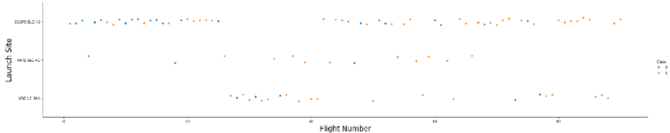
Flight Number vs. Launch Site
CCAFS SLC 40 has the highest number of Flight Numbers.

Slide 19
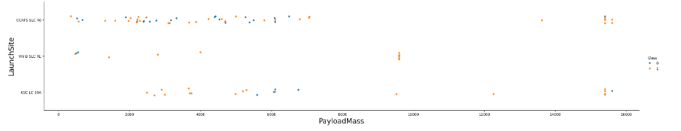
Payload vs. Launch Site
Looking at the scatter plot of payload versus launch site, it can be seen that at the VAFB-SLC launch site, rockets with a heavy payload mass (over 10,000) have not been launched.

Slide 20
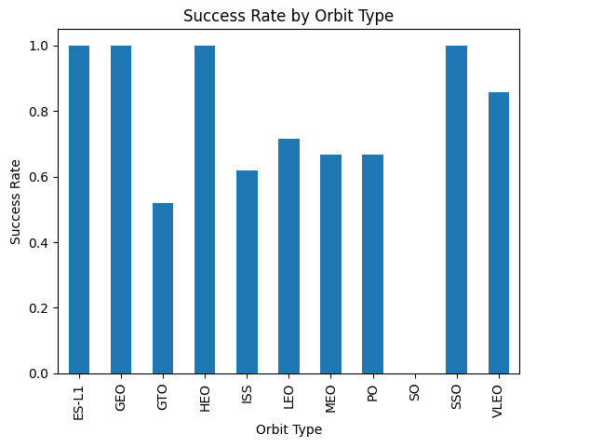
Success Rate vs. Orbit Type
Analyze the ploted bar chart try to find which orbits have high sucess rate.

Slide 21
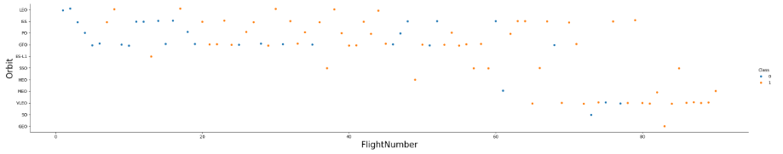
Flight Number vs. Orbit Type
In LEO orbit, success seems to be related to the number of flights, but in GTO orbit, there appears to be no relation to the number of flights.

Slide 22
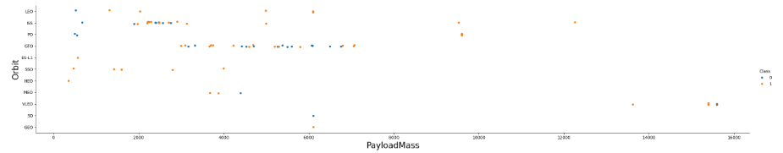
Payload vs. Orbit Type
With heavy payloads the successful landing or positive landing rate are more for Polar,LEO and ISS.

Slide 23
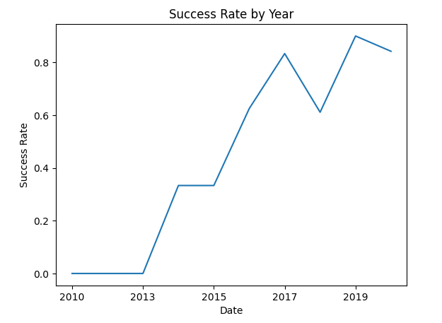
Launch Success Yearly Trend
From 2013 to 2020, the success rate has been steadily increasing.

Slide 24
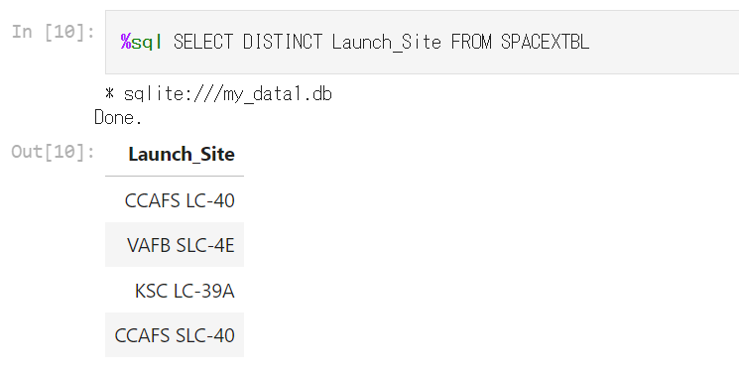
All Launch Site Names
Extract unique values from the 'Launch_Site' column using the DISTINCT method

Slide 25
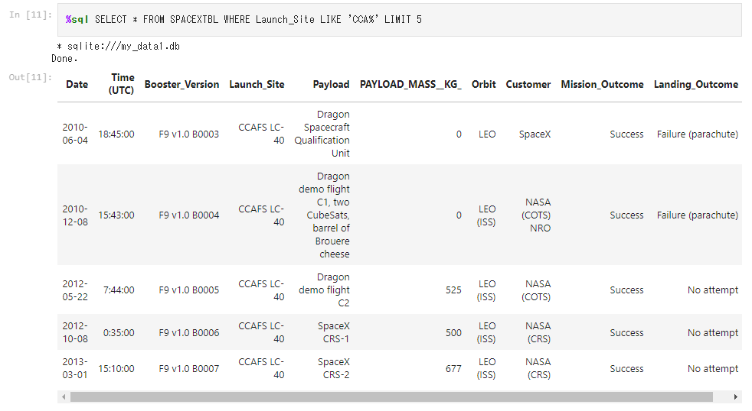
Launch Site Names Begin with 'CCA'
Select and display the first 5 rows from the SPACEXTBL table where the Launch_Site column starts with 'CCA’.

Slide 26
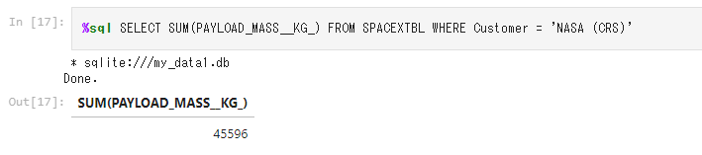
Total Payload Mass
Calculate the total sum (total payload mass) of the PAYLOAD_MASS__KG_ column values for all rows in the SPACEXTBL table where the value of the Customer column is 'NASA (CRS)'.

Slide 27
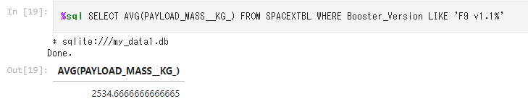
Average Payload Mass by F9 v1.1
Calculate the average (mean payload mass) of the values in the PAYLOAD_MASS__KG_ column for all rows in the SPACEXTBL table whose value in the Booster_Version column begins with 'F9 v1.1’.

Slide 28
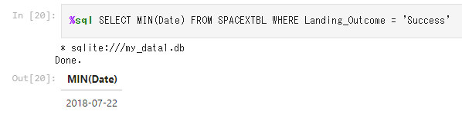
First Successful Ground Landing Date
Find the earliest date (the date of the first successful landing) among all rows in the SPACEXTBL table where the value of the Landing_Outcome column is 'Success' (successful landing).

Slide 29
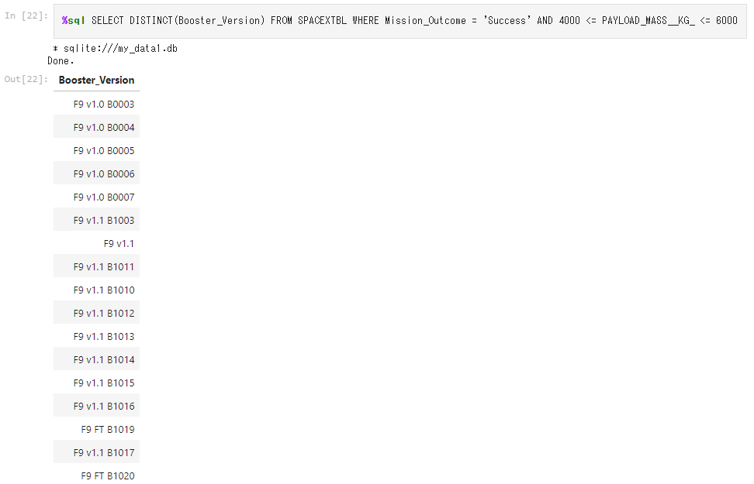
Successful Drone Ship Landing with Payload between 4000 and 6000
List all unique booster versions in the SPACEXTBL table that have a "successful" mission outcome and a payload mass in the range of 4000 kg to 6000 kg.

Slide 30
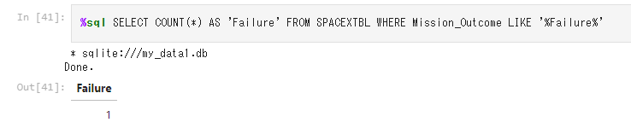
Total Number of Successful and Failure Mission Outcomes
Count the number of all rows in the SPACEXTBL table that contain 'Failure' in the Mission_Outcome column.

Slide 31
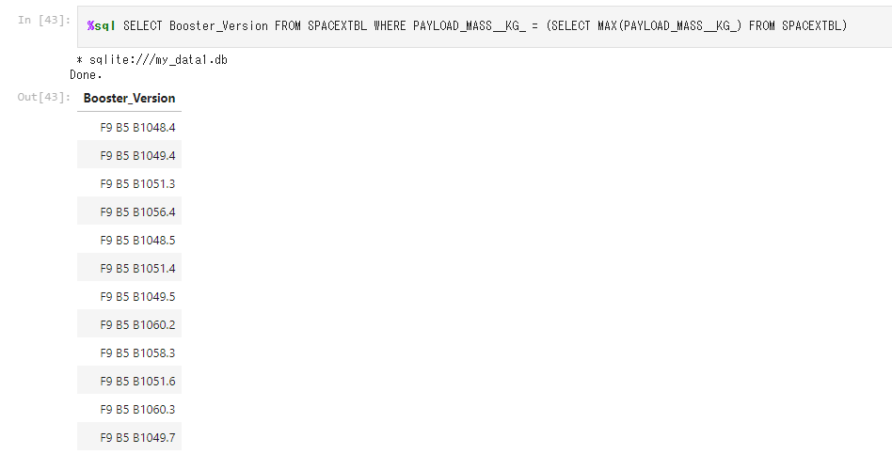
Boosters Carried Maximum Payload
Identify the booster version of the mission with the heaviest (largest) payload mass in the SPACEXTBL table.

Slide 32
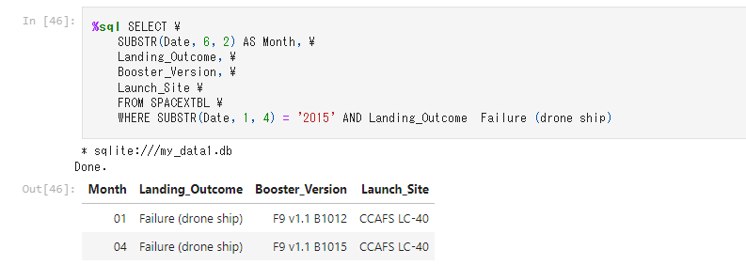
2015 Launch Records
Information on failed drone ship landing missions in 2015 (month, landing outcome, booster version, launch site) selected from the SPACEXTBL table.

Slide 33
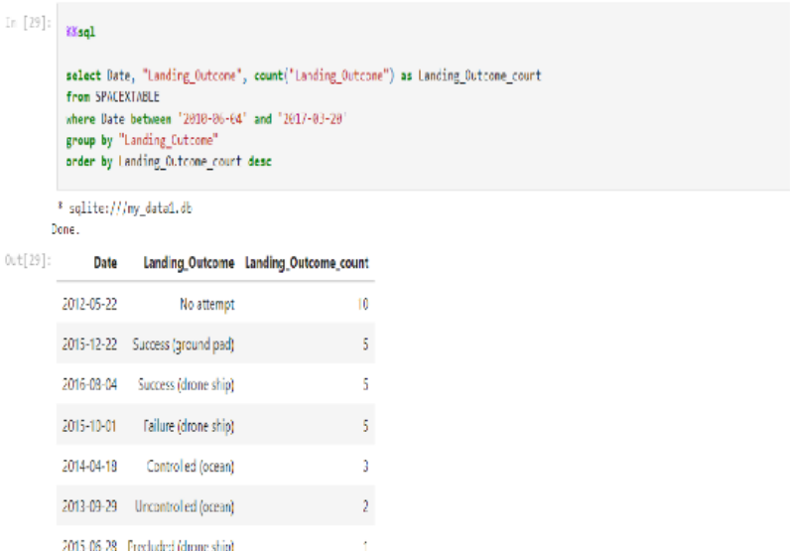
Rank Landing Outcomes Between 2010-06-04 and 2017-03-20
Rank the count of landing outcomes (such as Failure (drone ship) or Success (ground pad)) between the date 2010-06-04 and 2017-03-20,

Slide 34

Section 3

Slide 35
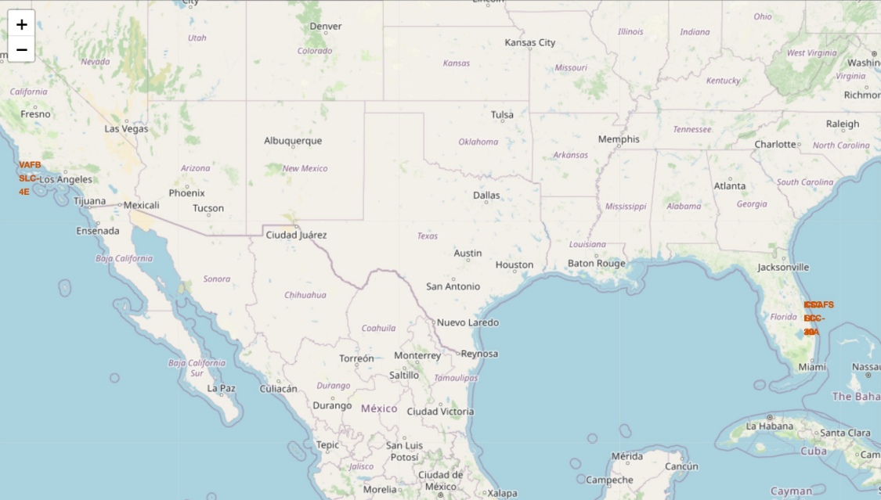
<All launch sites location markers on global map>
All launch sites in very close proximity to the coast

Slide 36
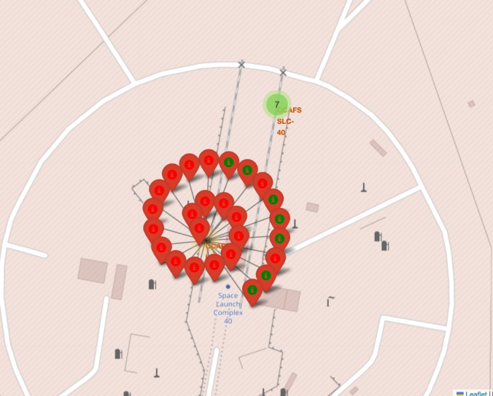
<Color-labeled launch outcomes>
the number of launches for each launch sites

Slide 37
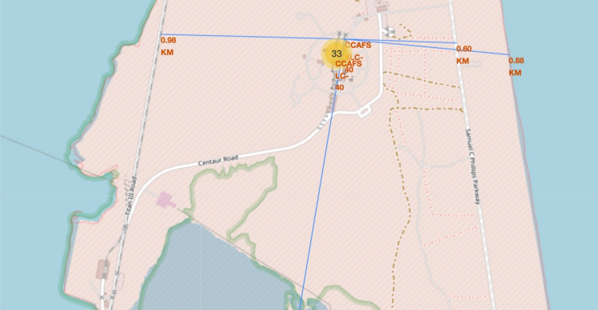
<Distance calculated to railway, highway, coastline>
The launch site is very close to railway, highway, and coastline

Slide 38

Section 4

Slide 39
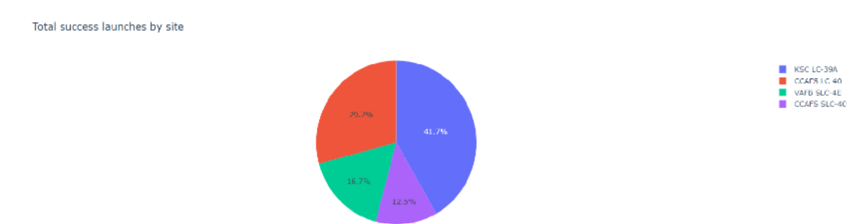
<Total Success Launches by Site>
KSC LC-39A has highest launches.

Slide 40
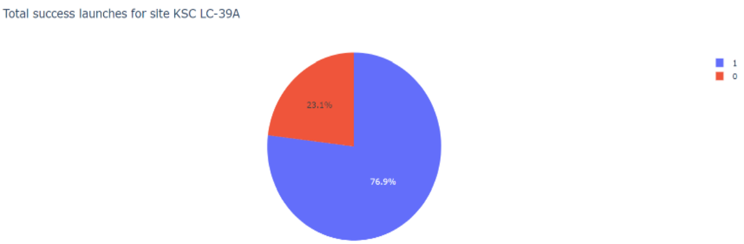
<Total Success KSC LC-39A>
KSC LC-39A has high score of total success.

Slide 41
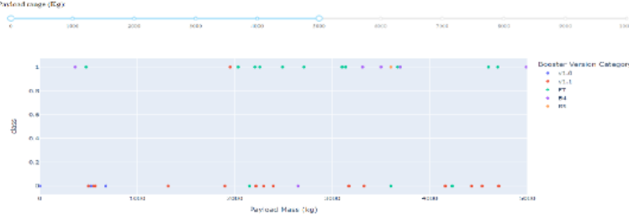
<Payload vs. Launch Outcome>
Payload and Lauch are greate factors from high score of total success.

Slide 42

Section 5

Slide 43
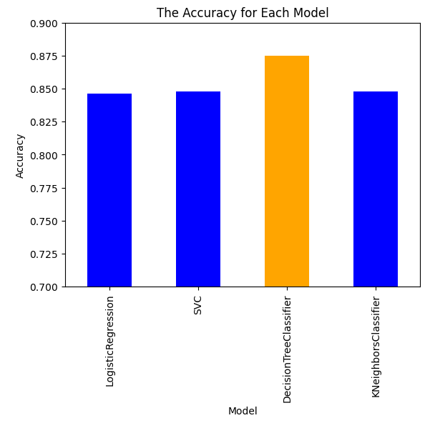
Classification Accuracy
The best model is the Decision Tree Classifier.

Slide 44
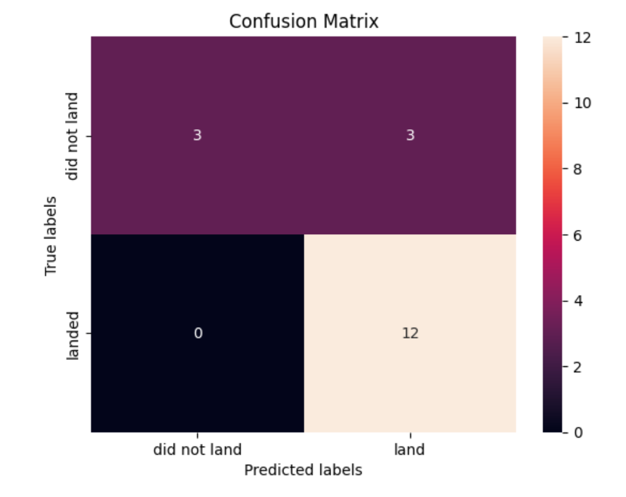
Confusion Matrix
The confusion matrix indicates the accuracy of the model.

Slide 45
Conclusions
Point 1
Point 2
Point 3
Point 4
…

Slide 46


